Slide 1
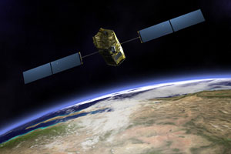
Global Patterns of Variability
Using Chemical Tracers
Yuk Ling Yung
Caltech
PKU Lecture 3
Oct 26 2016

Slide 2
Outline
Background
Interannual Variability in Low-latitude Ozone
Interannual Variability in High-latitude Ozone
2

Slide 3
Why Stratosphere?
Ozone Layer (Chemistry)
Thermal Inversion (Radiation)
Quasi-biennial Oscillation (Dynamics)
Global Climate Change
3

Slide 4
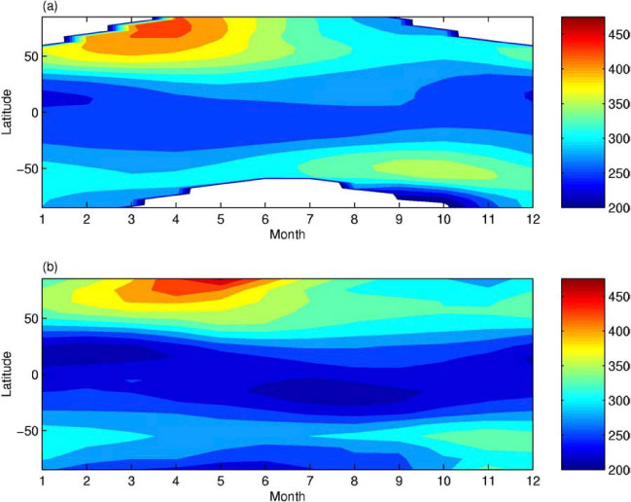
Ozone Climatology: 1979-2002
MOD
DU
2D CTM
DU

Slide 5
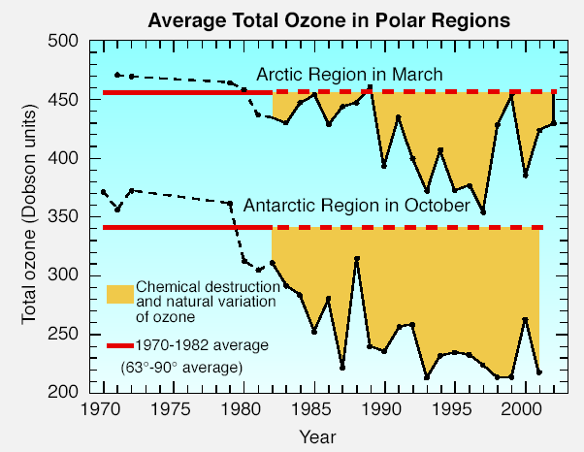
Large O3 changes
5

Slide 6
How Will the Stratosphere Affect
Climate Change?
Mark P. Baldwin, Martin Dameris, Theodore G. Shepherd,
Science 2007

Slide 7
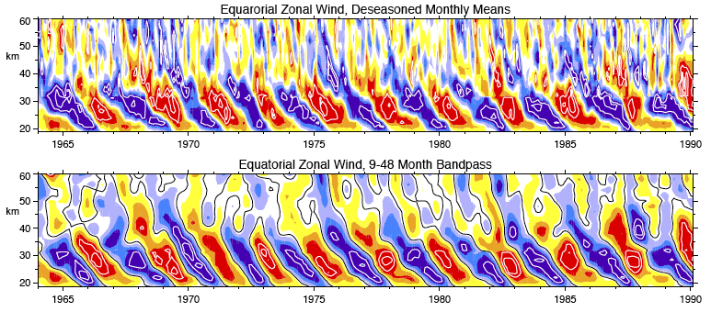
Quasi-Biennial Oscillation (QBO)
Westward and eastward wind regimes periodically repeat
Average period: 28 months;
Inter-annual variability: 22-34 months
Lindzen and Holton 1965
Baldwin et al. [2001]
Downward propagation:
1 km/month
Shear zone descent
7
Notes:
Discovered by Reed in 1961 and independently by Veryard and Ebdon
Quasi-biennial Oscillation is observed in the equatorial mean zonal wind in the stratosphere. The QBO signal is also found in the mesosphere but the largest amplitude is observed in the lower stratosphere. The easterly and westerly zonal wind regimes altered regularly with averaged period of 28 months. The QBO period has interannual variability, ranging from 22 to 34 months. The time-height cross section show it first appear above 30 km, the easterly and westerly QBO regimes propagate downwards at a rate of 1 km/month. The oscillation is symmetric about the equator with a maximum amplitude of about 20 m/s, and an approximately Gaussian distribution in latitude with a half-width of about 12 degree. The QBO signal is also found in the ozone and temperature and can be transported to polar region.

Slide 8
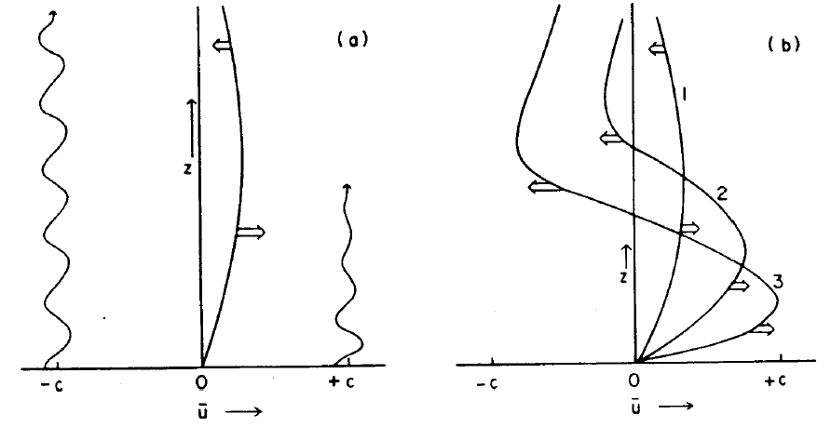
QBO mechanism
8

Slide 9
Outline
Background
Interannual Variability in Low-latitude Ozone
Interannual Variability in High-latitude Ozone
9

Slide 10

Principal Component Analysis

Slide 11
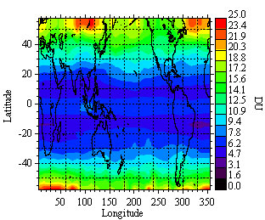
Ozone Variability
Camp et al. 2003

Slide 12
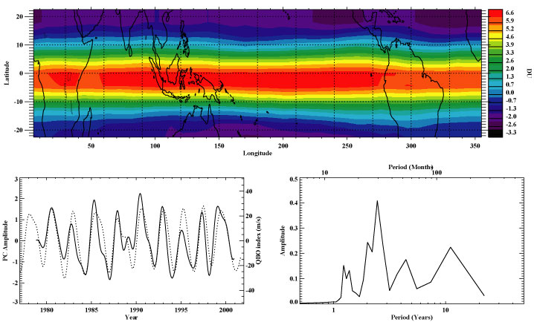
MOD EOF 1: QBO (and Decadal)
R=0.80 ( 1% )
Captures 42% of the interannual variance.

Slide 13
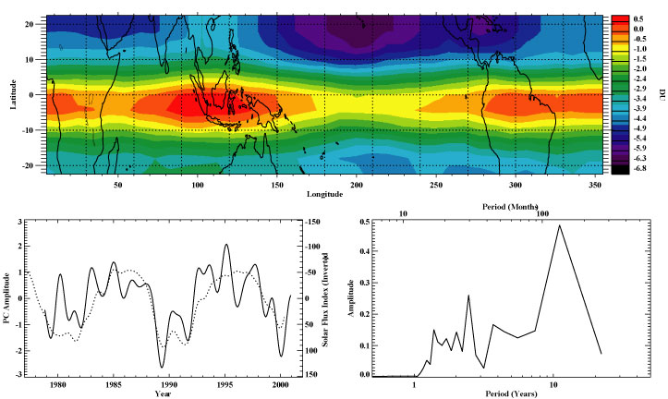
MOD EOF2: Decadal and QBO
R= -0.73 ( 5% )
Captures 33% of the interannual variance.

Slide 14
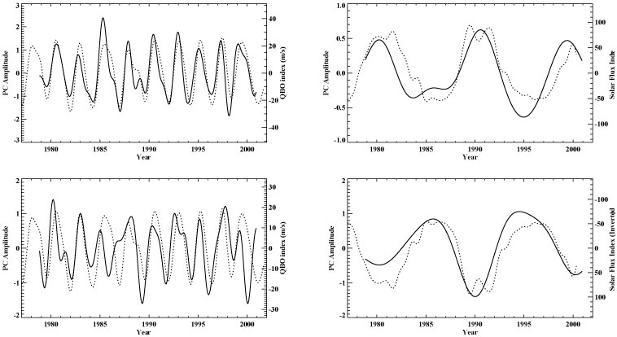
Filtered PCs 1 & 2: Separating the QBO and Decadal signals
[15, 72] mo.
[72, max] mo.
PC1
PC2

Slide 15
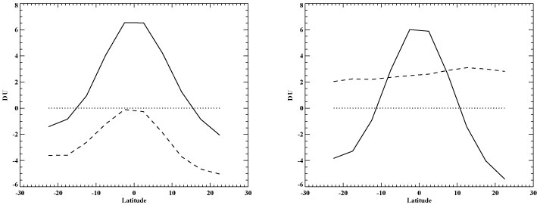
Linear Combinations of EOFs 1 & 2:
Patterns for QBO and Decadal Signals
Using the standard deviations of the filtered PCs as weights, take weighted sum and difference of EOFs 1 & 2. (Zonal averages shown)
diff => decadal
EOF 1
EOF2
sum => QBO

Slide 16
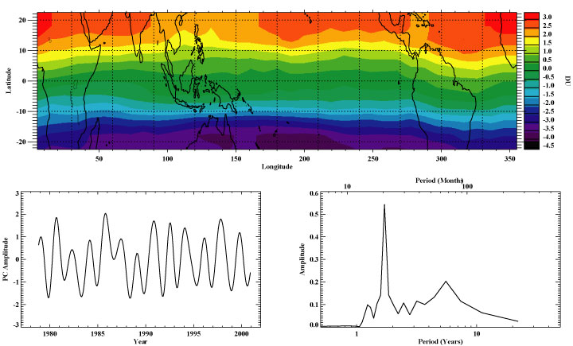
EOF 3: interaction between QBO and annual cycles (QBO-annual beat)
Captures 15% of the interannual variance.

Slide 17
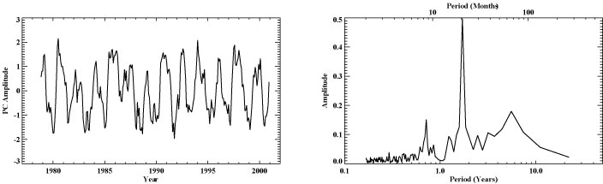
QBO-annual beat
(analysis with intra-annual variability)
Quadratic nonlinearity between the QBO and annual cycles creates signals with periods of 20 and 8.6 months (for a average QBO period of 30 months):

Slide 18
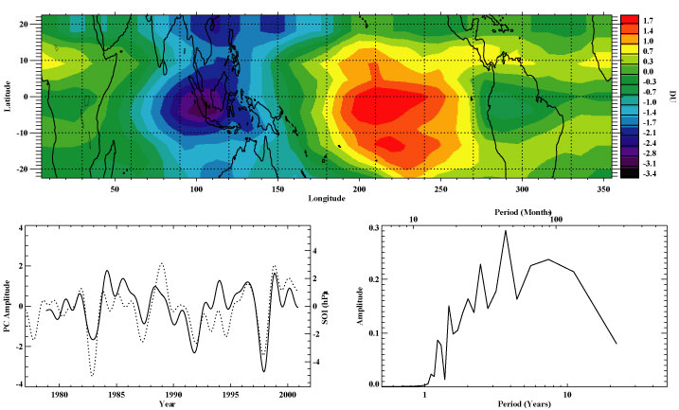
EOF 4: ENSO
R=0.71 ( < 0.1% )
Captures 3% of the interannual variance.

Slide 19
Outline
Background
Interannual Variability in Low-latitude Ozone
Interannual Variability in High-latitude Ozone
19

Slide 20
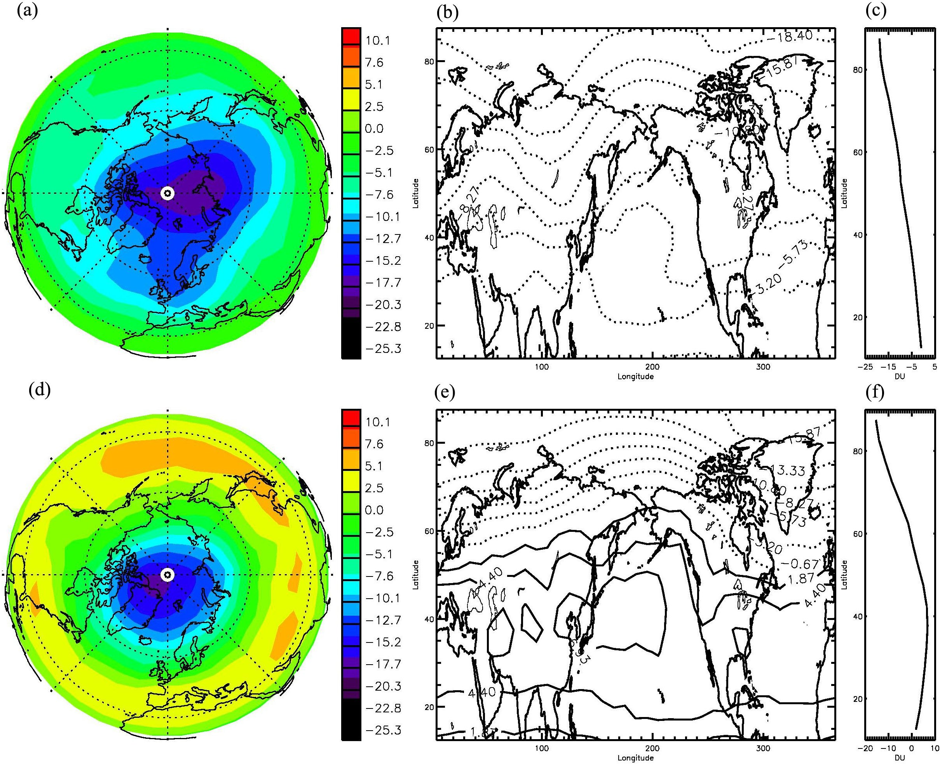
EOF Patterns of Combined Column O₃ in NH
Jiang et al. 2008a,b
Units: DU
1st
30.4%
2nd
15.9%
20

Slide 21
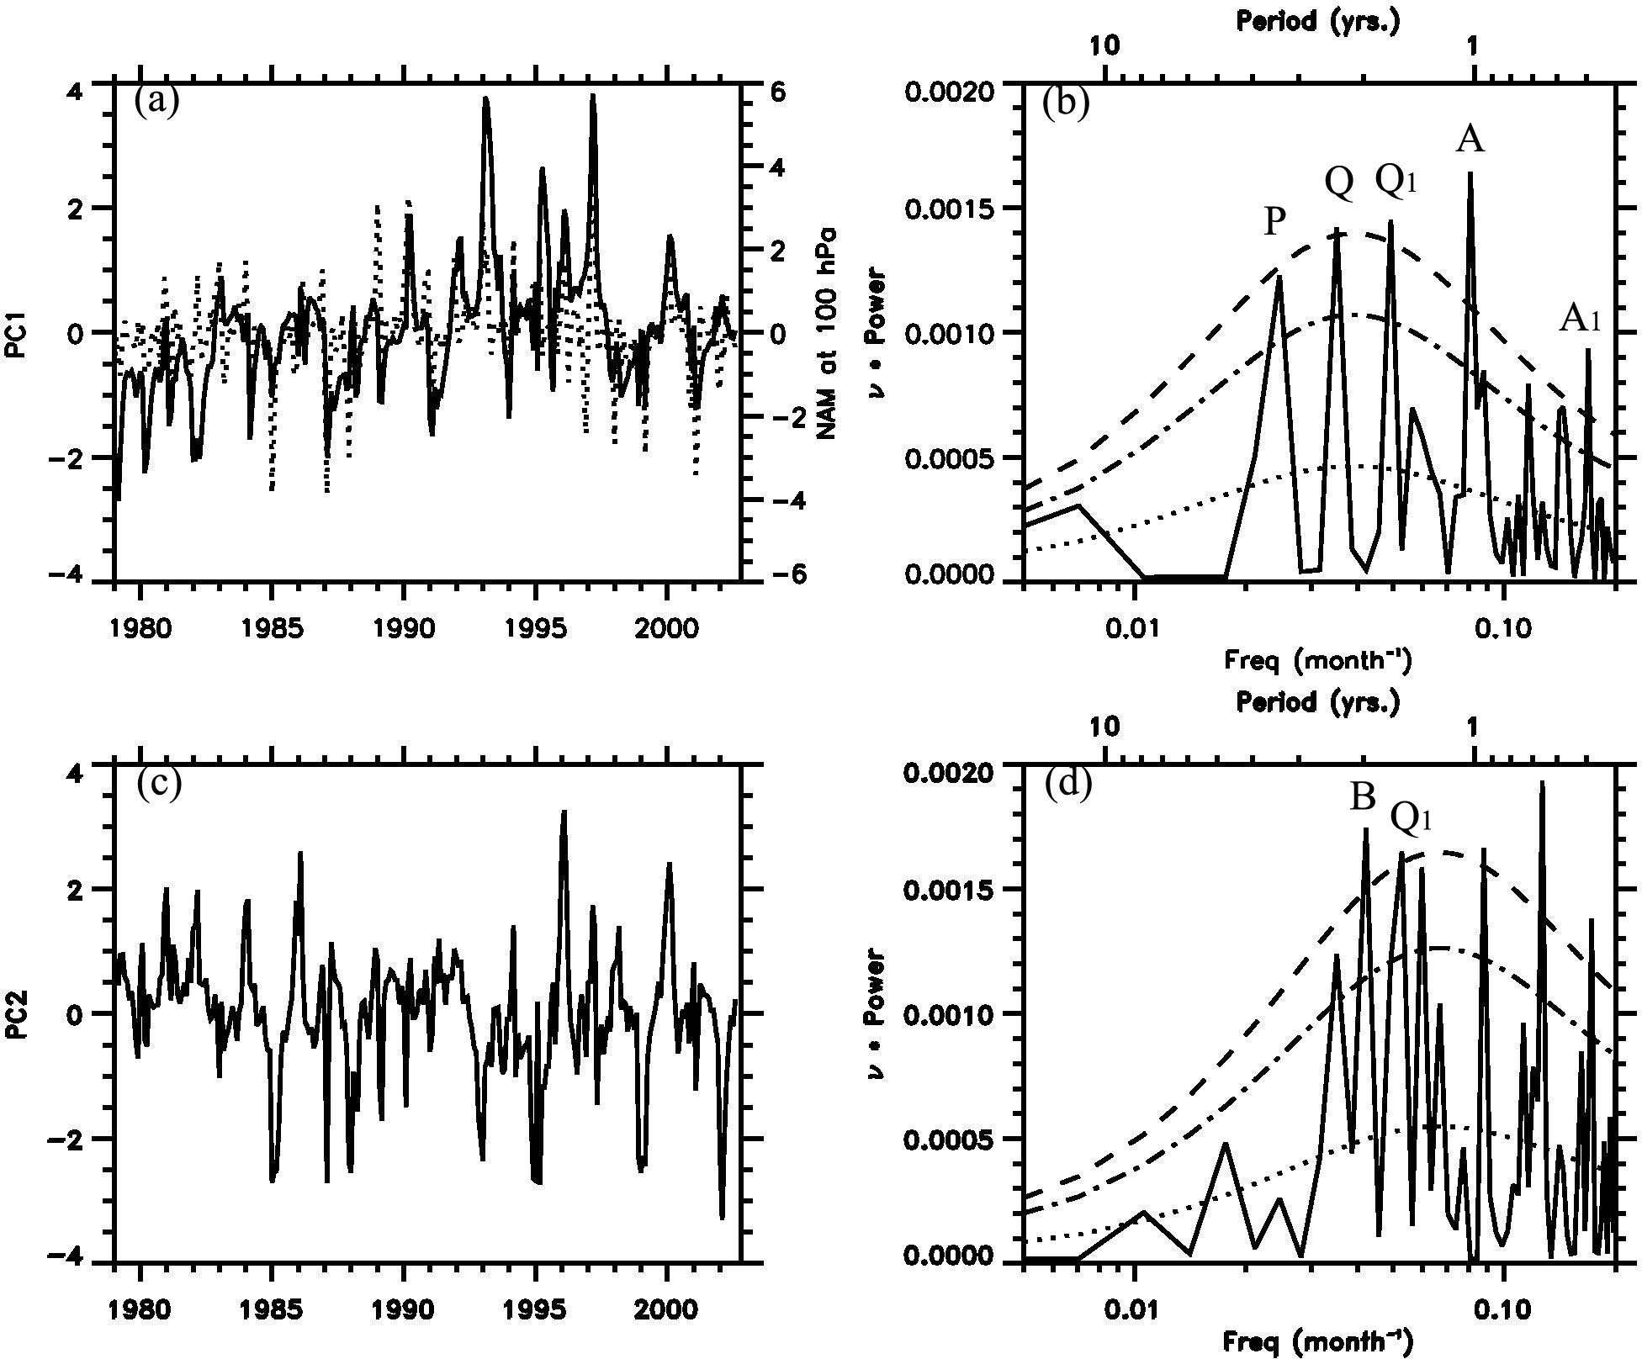
PC timeseries and Power Spectra of O₃ in NH
Power Spectra
PCs
Cor. Coeff.
0.53
21

Slide 22
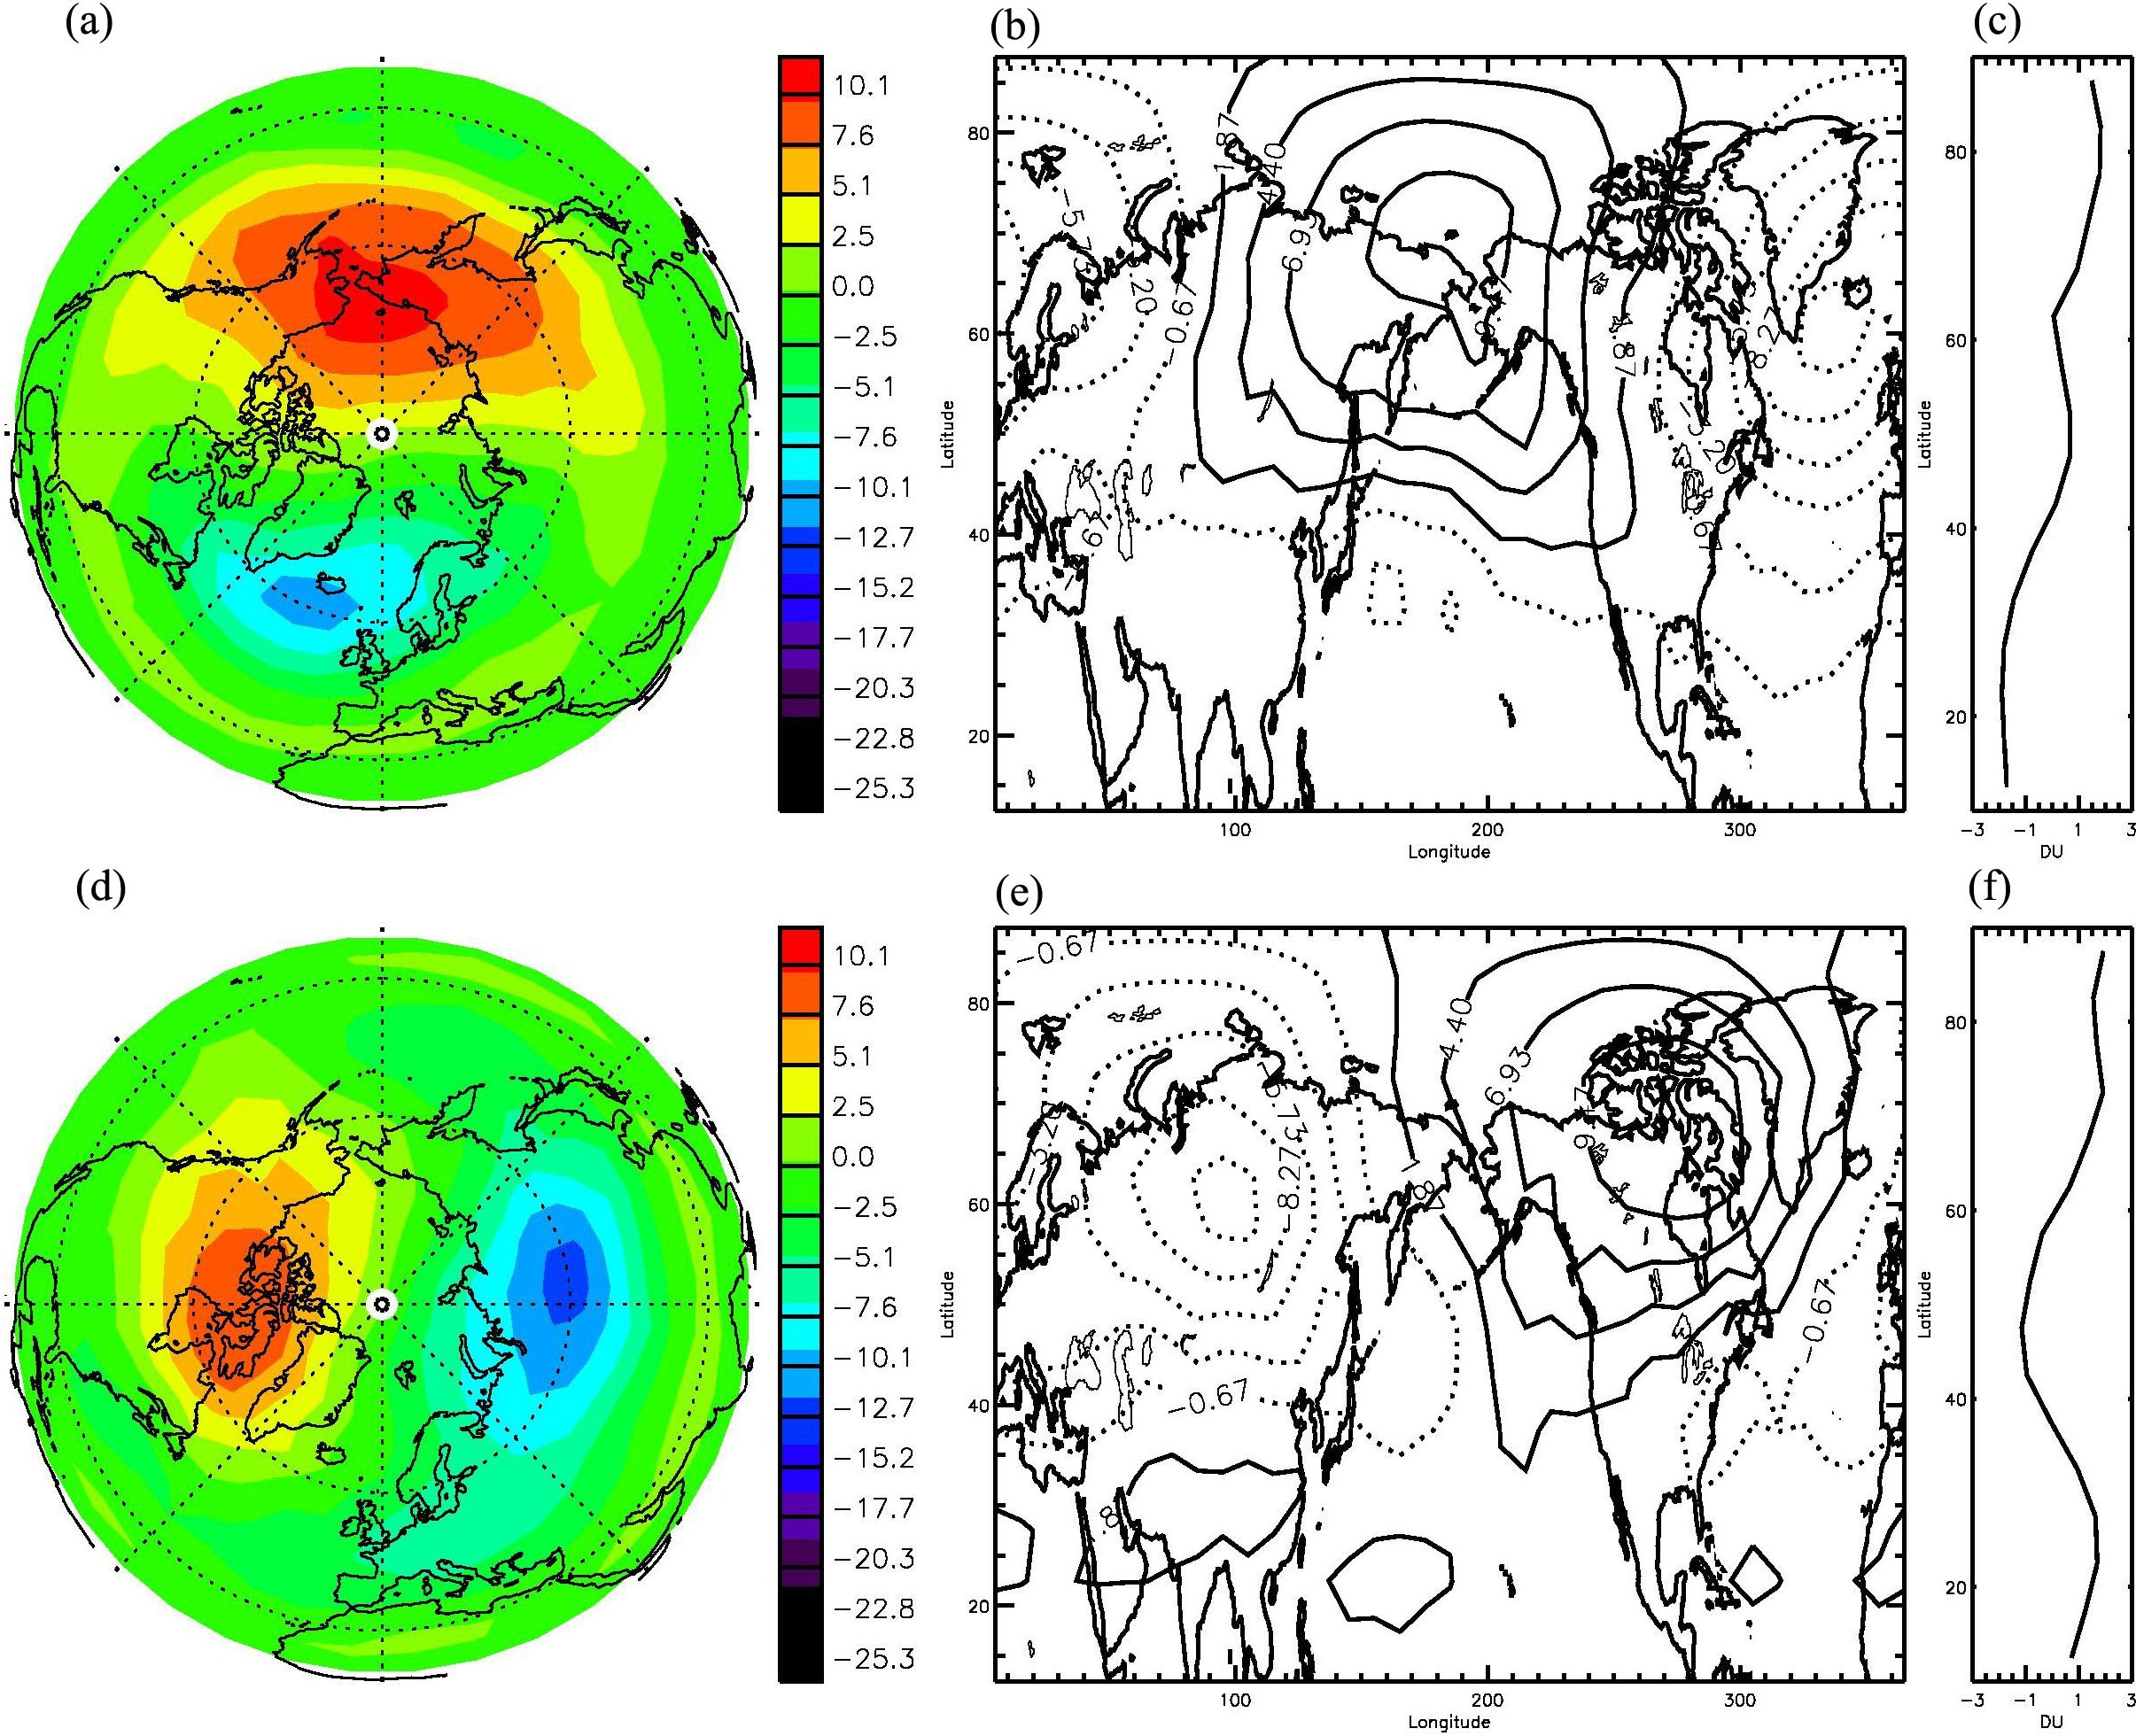
EOF Patterns of Combined Column O₃ in NH
Units: DU
3rd
7.1%
4th
6.5%
22

Slide 23
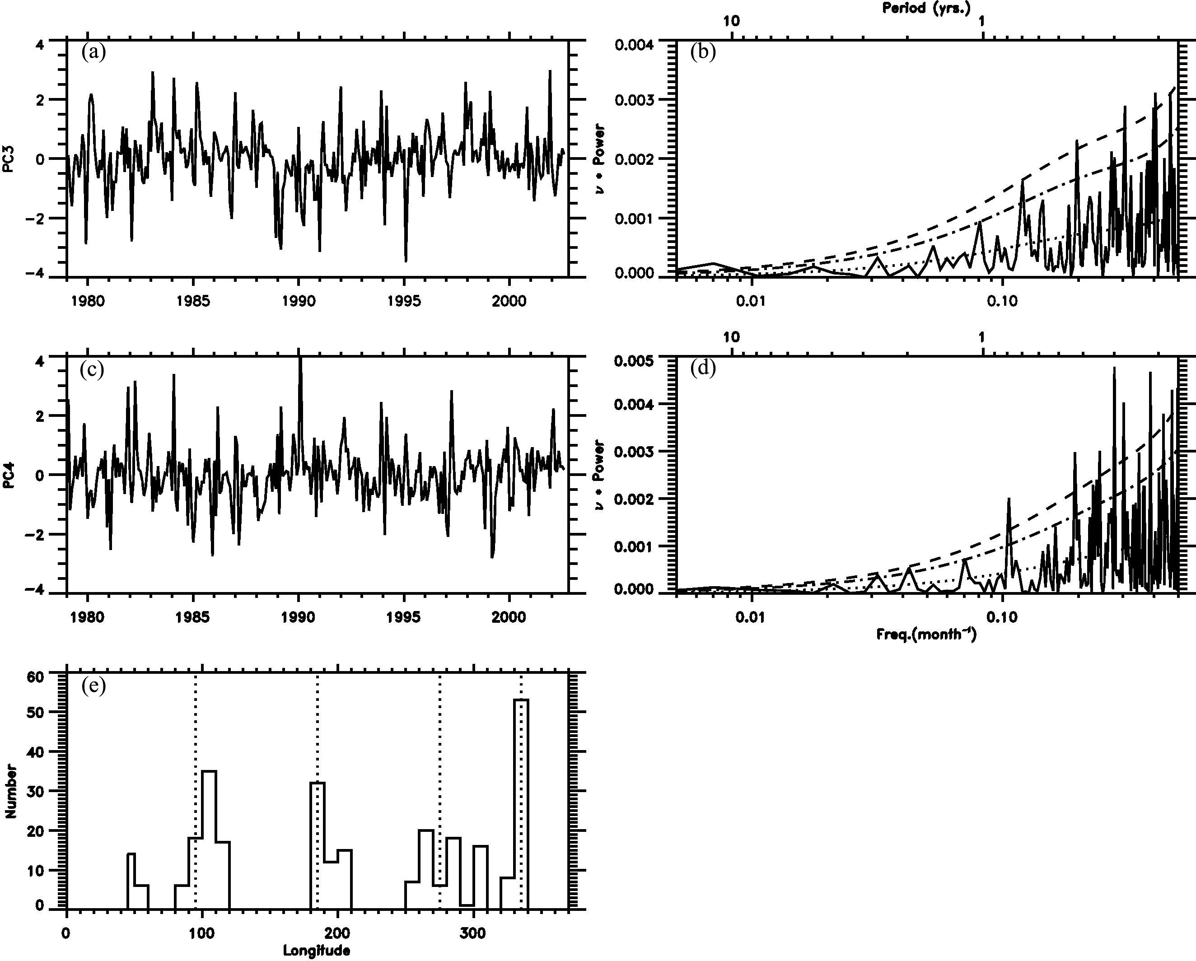
PC timeseries and Power Spectra of O₃ in NH
PCs
Power Spectra
Histogram of the longitude for the maxima of p₃(t)C₃(θ, ϕ) + p₄(t)C₄(θ, ϕ)

Slide 24
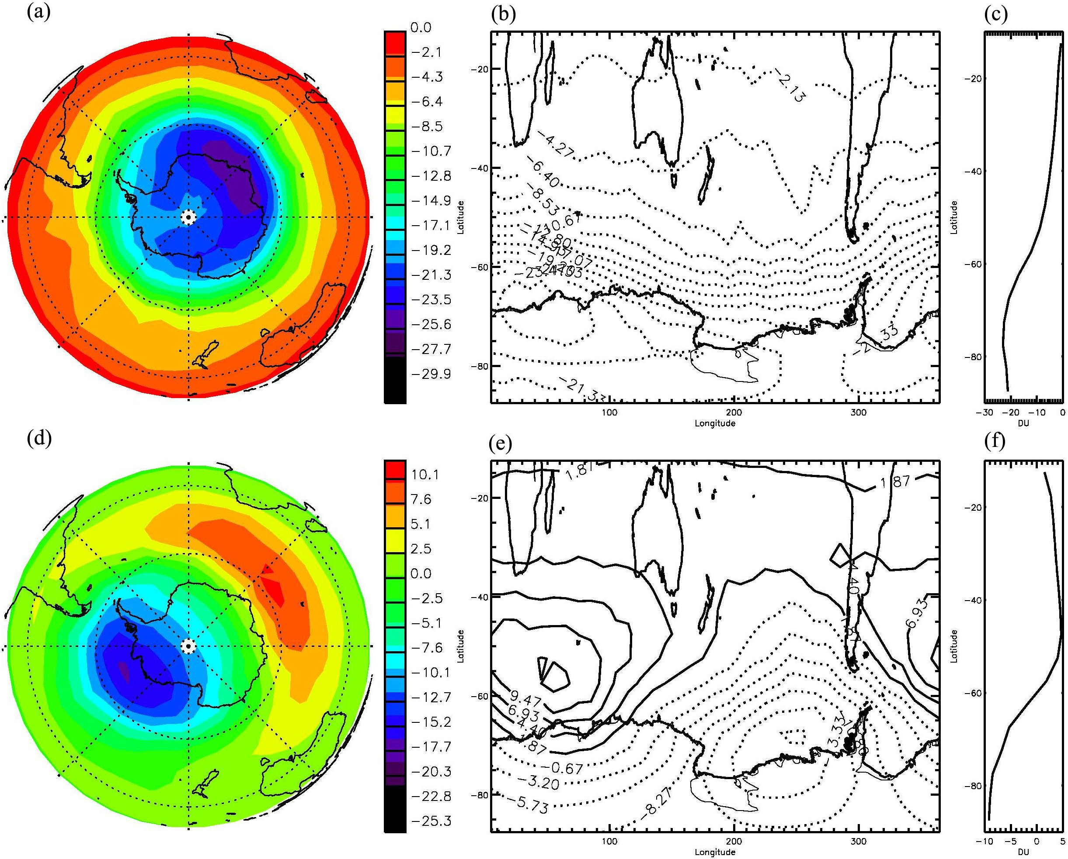
EOF Patterns of Combined Column O₃ in SH
Units: DU
1st
43.9%
2nd
13.7%
24

Slide 25
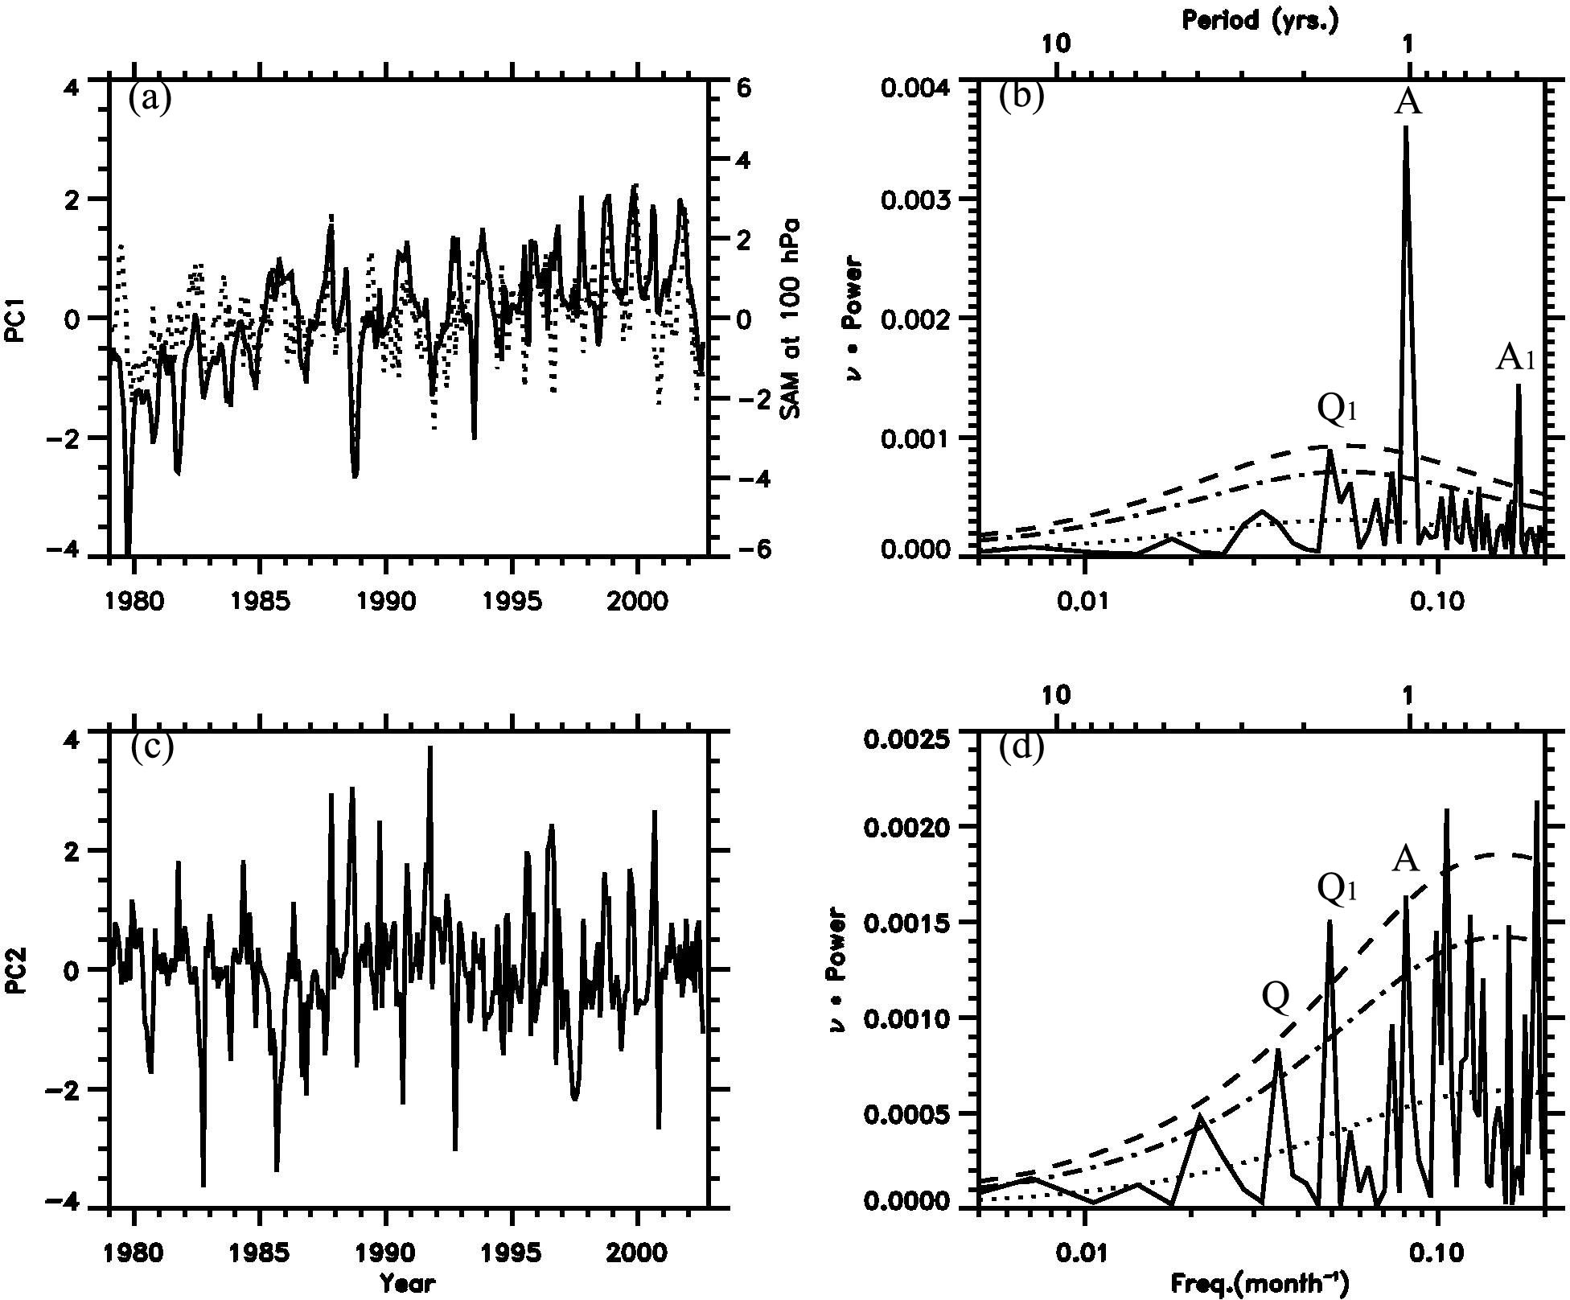
PC timeseries and Power Spectra of O₃ in SH
PCs
Power Spectra
Cor. Coeff.
0.45

Slide 26
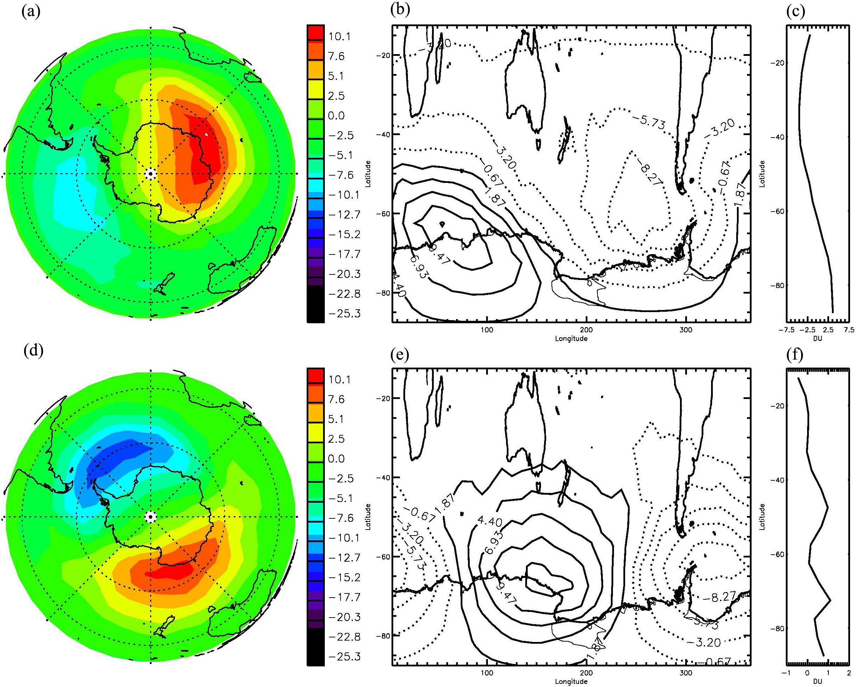
EOF Patterns of Combined Column O₃ in SH
Units: DU
3rd
9.8%
4th
7.4%
26

Slide 27
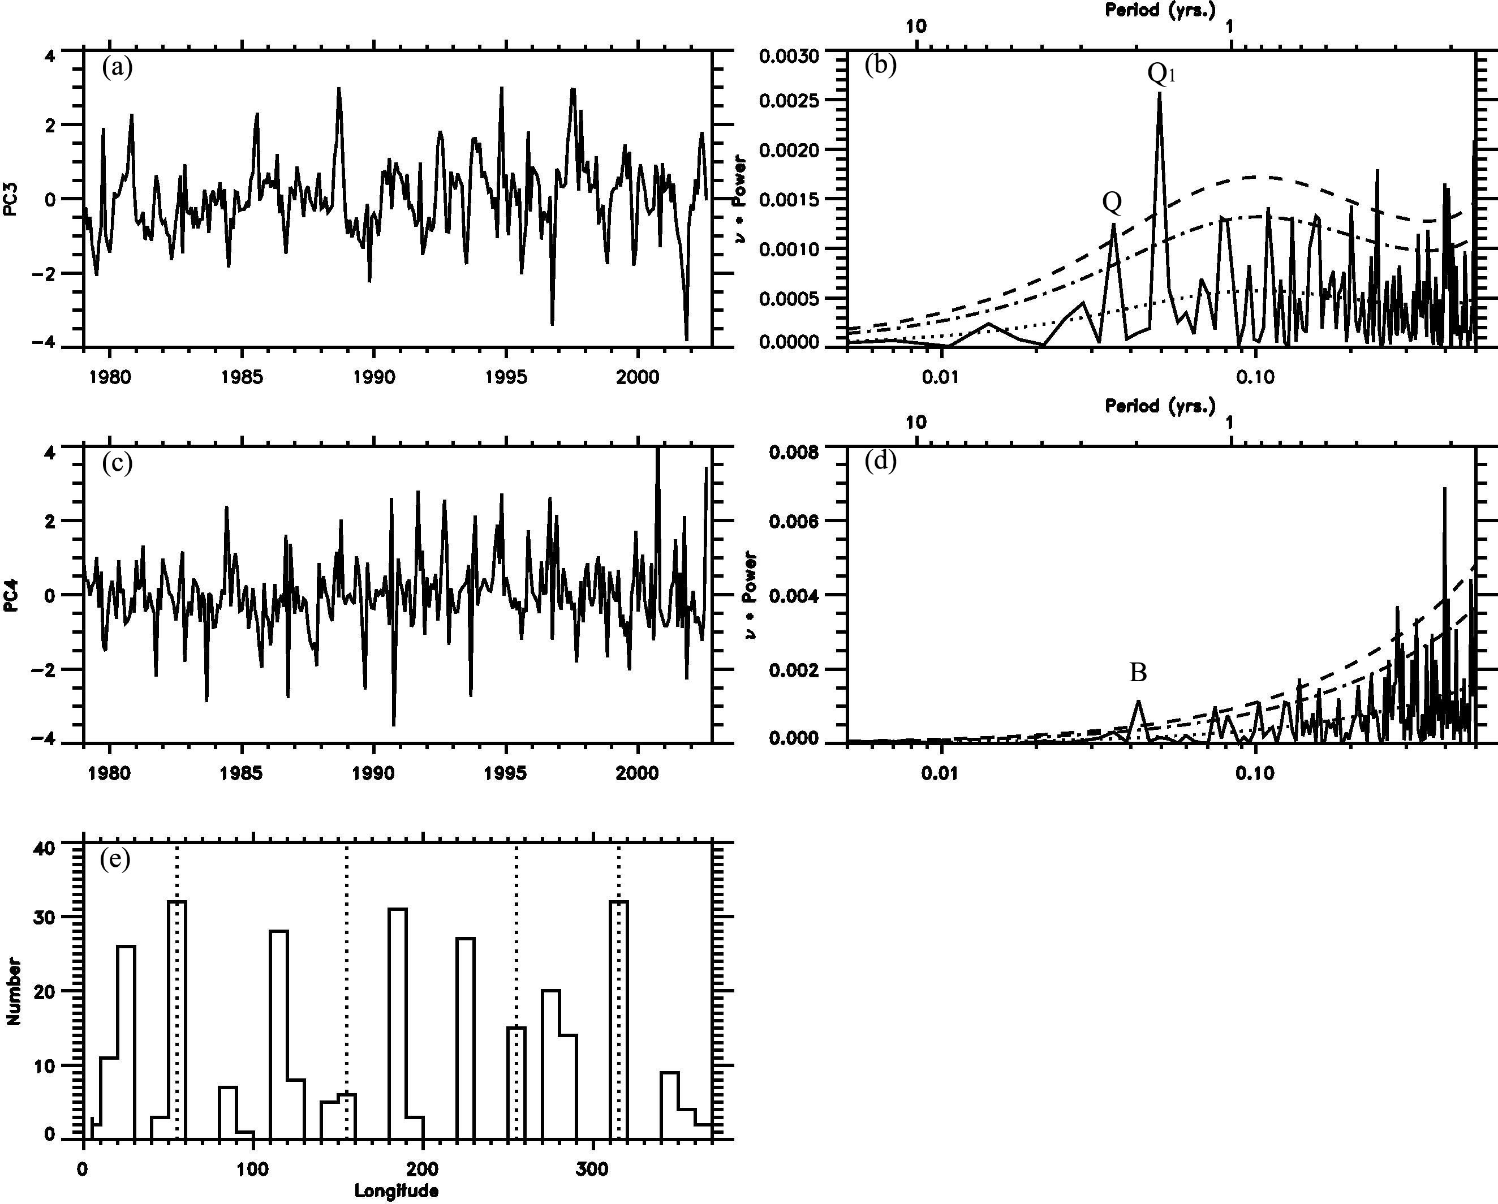
PC timeseries and Power Spectra of O₃ in SH
PCs
Power Spectra
Histogram of the longitude for the maxima of p₃(t)C₃(θ, ϕ) + p₄(t)C₄(θ, ϕ)

Slide 28
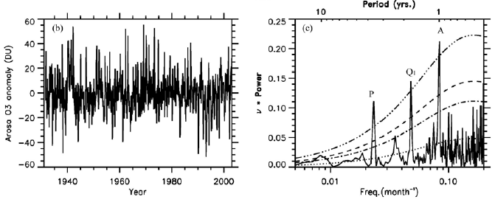
3.5-year Signal in the Arosa Ozone
Arosa (46N, 9E) column ozone time series (since Aug. 1931)
Signals in Spectra:
3.5 years, QBO-AB, QBO
Wang et al. 2011

Slide 29
Planetary science: Music of the stratospheres
Dowling Nature 453, 163-164 (8 May 2008)

Slide 30
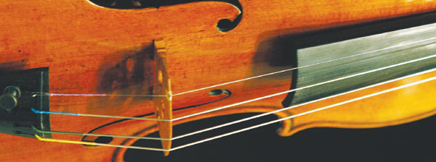
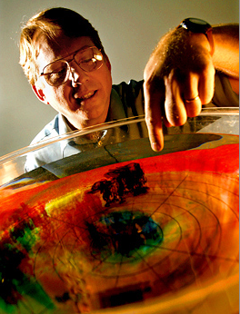
The strings are the troposphere, vibrating with many eastward- and westward-propagating waves. The bridge is the tropopause, transmitting the waves up into the soundbox, the stratosphere. The primary difference is that, unlike a typical string instrument, a stratosphere responds by dropping the input frequencies down by two or more orders of magnitude — from periods of minutes and days down to years.
Prof. Tim Dowling

Slide 32
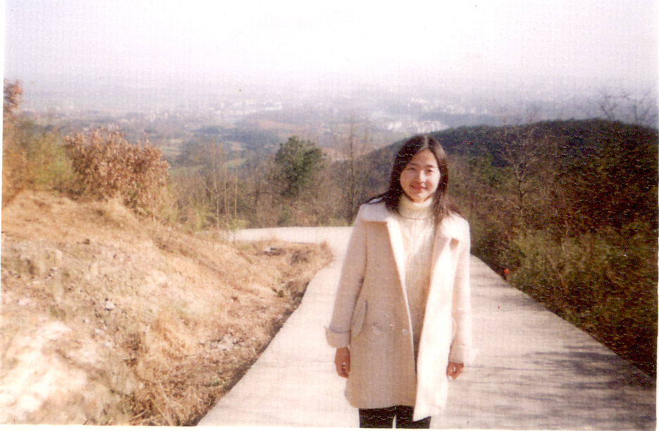

Prof. Xun Jiang (UH)
Dr. Le Kuai (UCLA)
32

Slide 33
Acknowledgements
David Camp
Xun Jiang
Le Kuai
33

Slide 34
Backup slides
34

